Slide 1

Department of Computer Science & Engineering
Proactive Multimodal Academic Support System
Batch no. 170
1. 2211CS010595 ( V. USHA)
2. 2211CS010571 ( U. SREEJA)
3. 2211CS010547 ( SUBHAPREET PATRO)
4. 2211CS010602 ( Y. BHAVANA)
Guide
Mr. B. Hari
Maisammaguda, Kompally, Medchal - Malkajgiri District Hyderabad - 500100, Telangana State. www.mallareddyuniversity.
(Telangana State Private Universities Act No. 13 of 2020 &
G.O.Ms. No. 14, Higher Education (UE) Department)

Slide 2
Table of Contents
Introduction
Limitations of Existing Algorithms
Objectives
Proposed Methodology
Literature Survey/Problem Formulation
Design and Implementation
Screenshots of Application
Results
Conclusion
References

Slide 3
Introduction
Modern academic systems are often fragmented and reactive, increasing workload and limiting timely student support. To address these challenges, this project presents a Proactive Multimodal Academic Support System that integrates academic management with AI-driven assistance. The system supports three roles—Student, Faculty, and Admin—with secure, role-based access. Core features include AI-based academic interaction, centralized timetable and event management, a knowledge base, and task modules for assignments and quizzes. Advanced capabilities such as automated administrative support, personalized academic scheduling, and continuous performance monitoring enable early intervention and reduce administrative bottlenecks. The system aims to enhance efficiency, improve learning outcomes, and provide proactive academic support.

Slide 4
Limitations of Existing Algorithms/Methodologies
Reactive Academic Support : Traditional academic systems address issues only after deadlines are missed or performance declines, offering limited scope for early intervention or personalized guidance.
Manual and Fragmented Processes : Academic and administrative tasks such as timetable updates, leave applications, and performance monitoring are handled manually across multiple platforms, leading to delays, errors, and increased workload.
Lack of Personalization : Existing systems follow a one-size-fits-all approach and do not adapt to individual student behavior, learning pace, or time availability, resulting in inefficient scheduling and reduced academic effectiveness.

Slide 5
Objectives
Centralized Role-Based Academic Management
To develop a centralized, role-based academic support system that securely manages timetables, events,
learning resources, assignments, and quizzes.
Proactive AI-Driven Academic Support
To provide proactive AI-driven academic assistance through intelligent automation, personalized scheduling, and early identification of academic risks.
Administrative and Faculty Workload Optimization
To reduce administrative and faculty workload by automating routine processes and enabling efficient, real-time academic management.
Enhanced Student Engagement and Learning Outcomes
To enhance student engagement and learning outcomes by providing timely, personalized guidance and structured academic planning.

Slide 6
Proposed Methodology
Role-Based System Design
Design and implement a secure, role-based architecture for Students, Faculty, and Admin, ensuring controlled access to academic modules such as timetable, events, tasks, and knowledge resources.
AI-Integrated Academic Intelligence
Integrate an AI assistant to provide academic guidance, automate administrative tasks, generate personalized schedules, and monitor student activity for early risk detection.
Centralized Data Management and Automation
Maintain a centralized database to manage academic records, tasks, schedules, and performance data, enabling real-time updates, automation, and efficient system-wide coordination.

Slide 7
Problem Formulation/Literature Survey
1.Study of Existing Systems
Existing academic systems are largely reactive, addressing issues only after deadlines are missed or student performance declines.
They rely on fragmented platforms for managing timetables, assignments, events, and learning resources, making academic coordination inefficient.
Students and faculty face delays and inconsistencies due to disconnected processes.
2. Techniques in Previous Research
Many studies focus on rule-based automation for handling administrative tasks like leave applications or notifications.
Predictive models have been applied to monitor student performance, but often with limited accuracy and scope.
Traditional LMS and timetable systems are mostly static, lacking integration with AI or real-time adaptive functionalities.

Slide 8
Problem Formulation/Literature Survey
3. Limitations & Research Gap
Existing systems provide generic support with minimal personalization or proactive guidance.
Manual processes increase the workload on faculty and administrators, causing delays and errors.
There is no unified system that integrates AI assistance, academic tasks, scheduling, and real-time performance monitoring.
4. Justification for Proposed Solution
The proposed system introduces AI-driven automation to handle administrative and academic tasks efficiently.
It enables personalized scheduling and continuous performance monitoring to support students proactively.
A centralized role-based system ensures secure access for students, faculty, and admin, improving coordination, reducing workload, and enhancing learning outcomes.

Slide 9
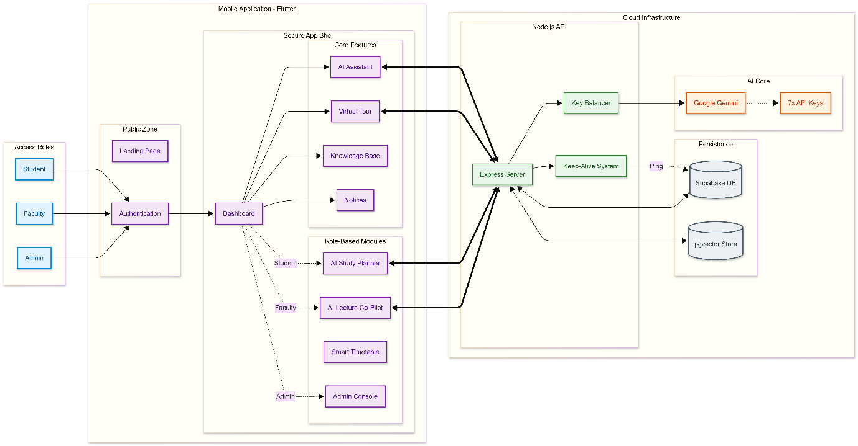
Design and Implementation
Architectural Diagram

Slide 10
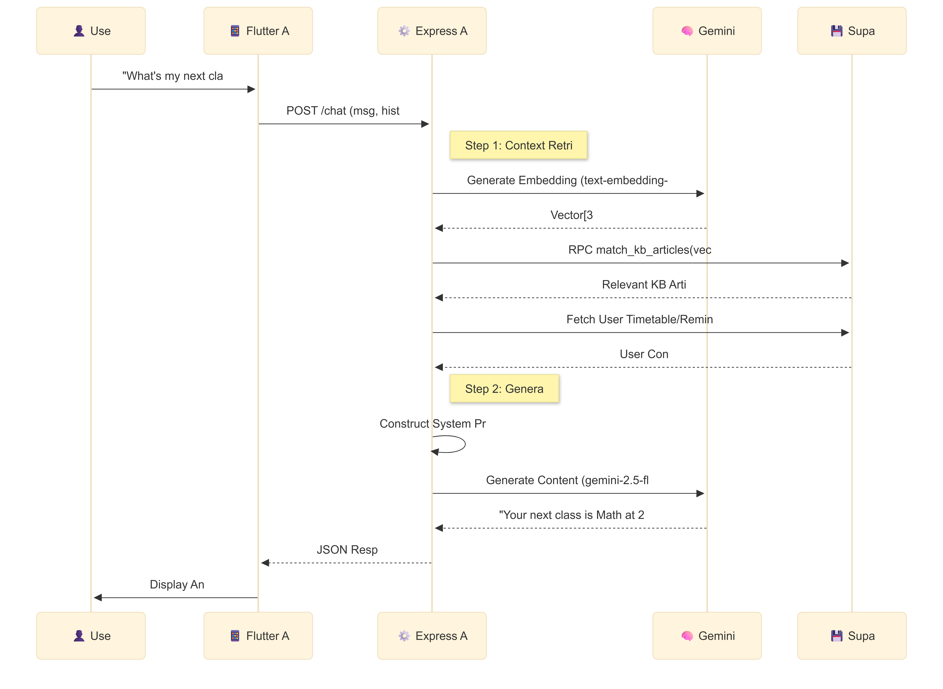
Design and Implementation
Sequence Diagram

Slide 11
Design and Implementation
Class Diagram

Slide 12
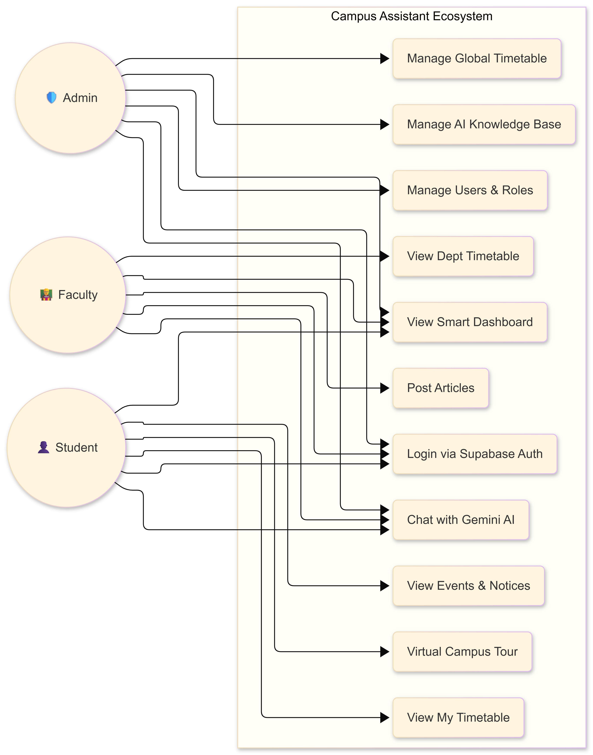
Design and Implementation
UseCase Diagram

Slide 13
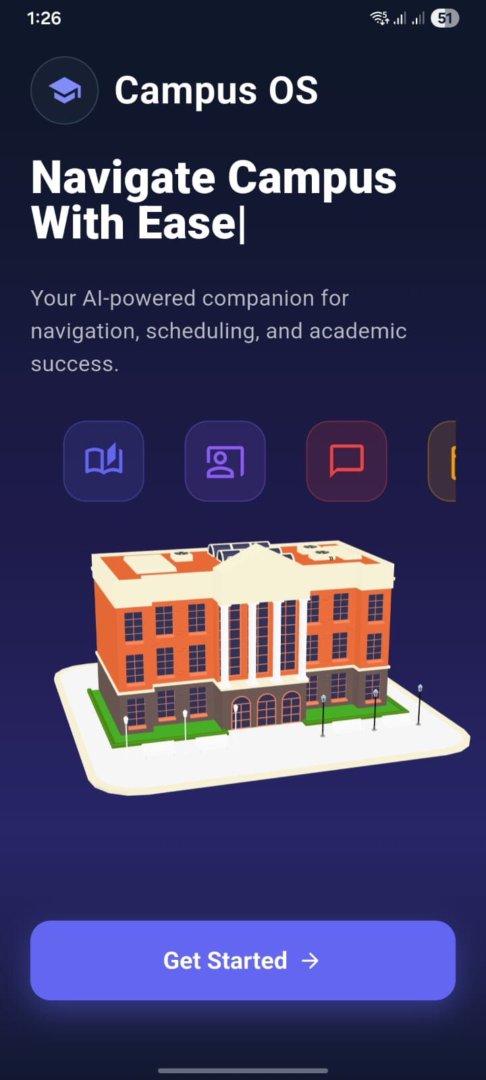
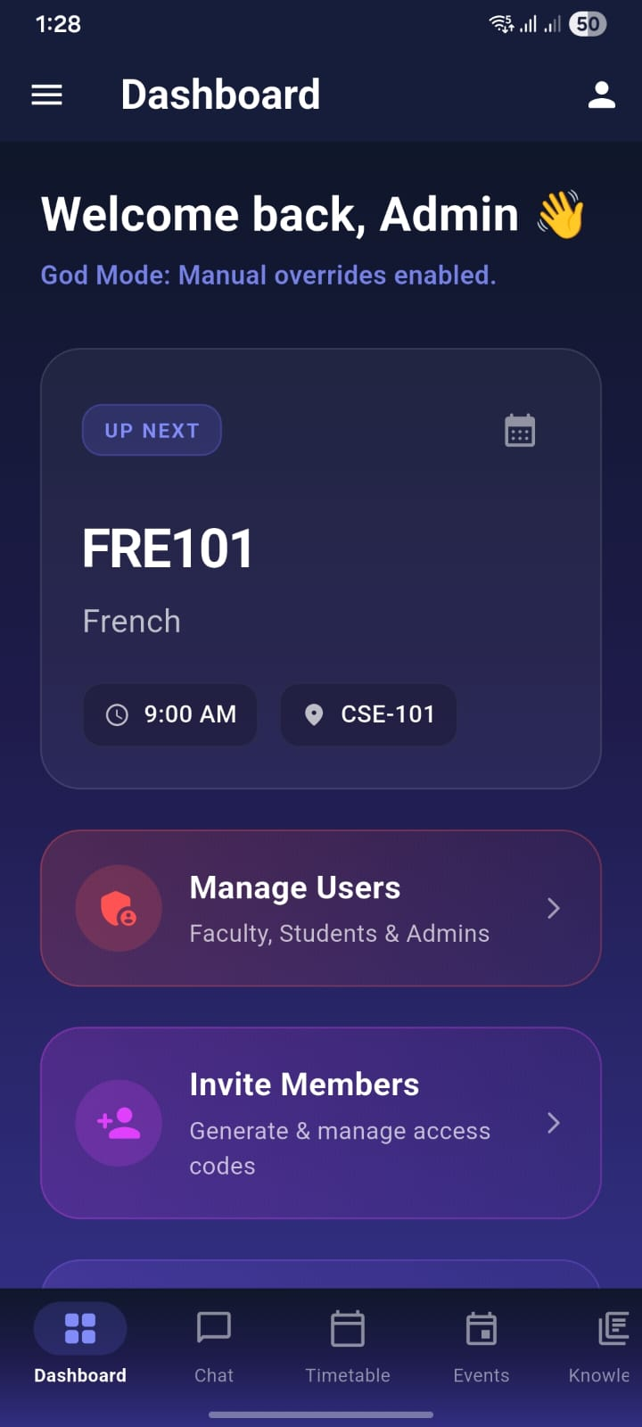
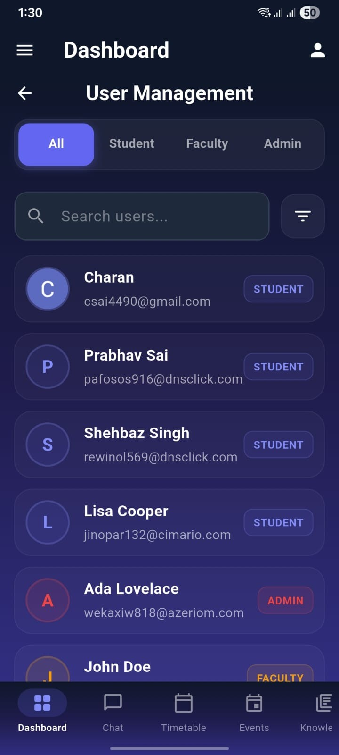
Screenshots of Application
Fig 1: Landing Page Fig 2: Admin Dashboard Fig 3: User Management Interface

Slide 14
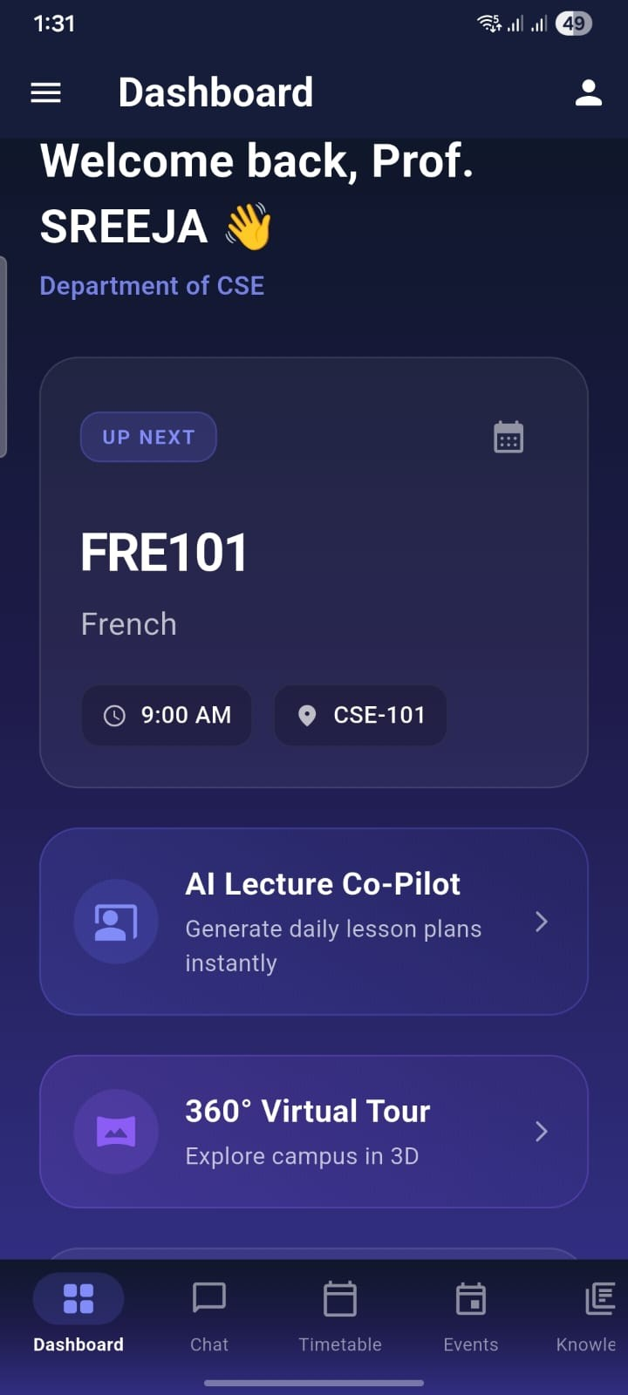
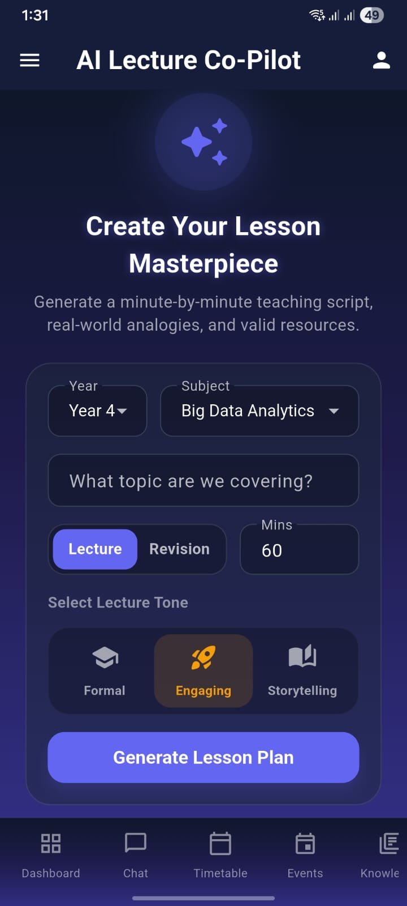
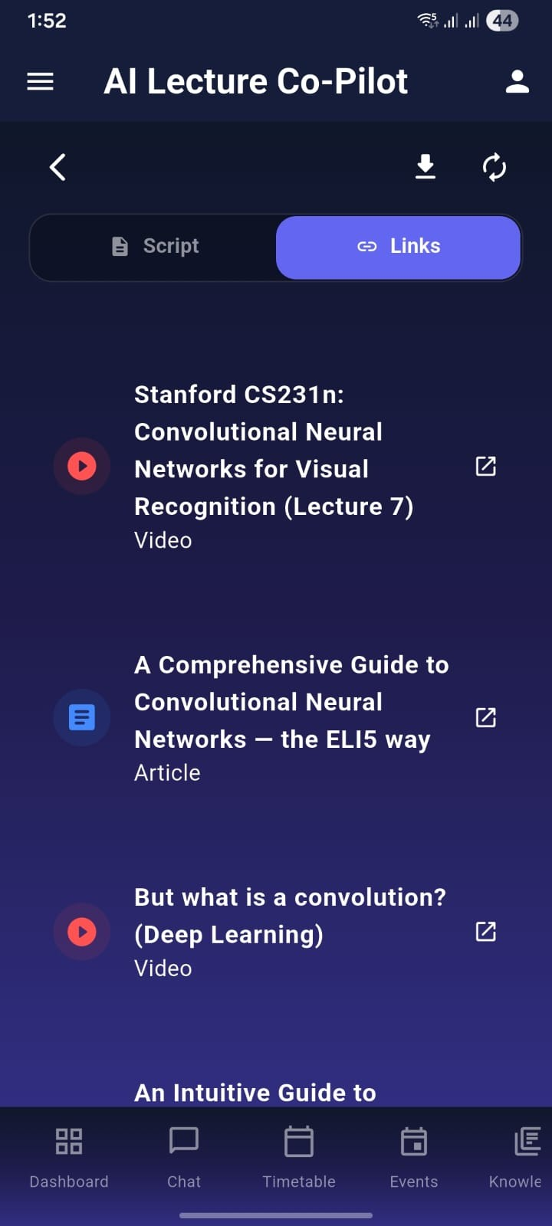
Screenshots of Application
Fig 4: Faculty Dashboard Interface
Fig 5: AI Lecture Co-Pilot Interface
Fig 6: Generated Lecture Links View

Slide 15
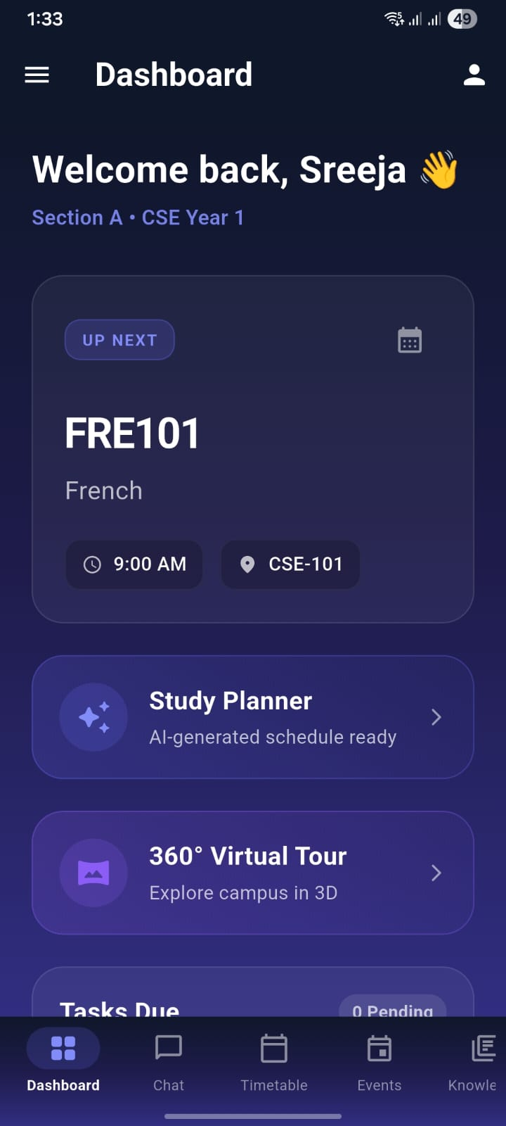
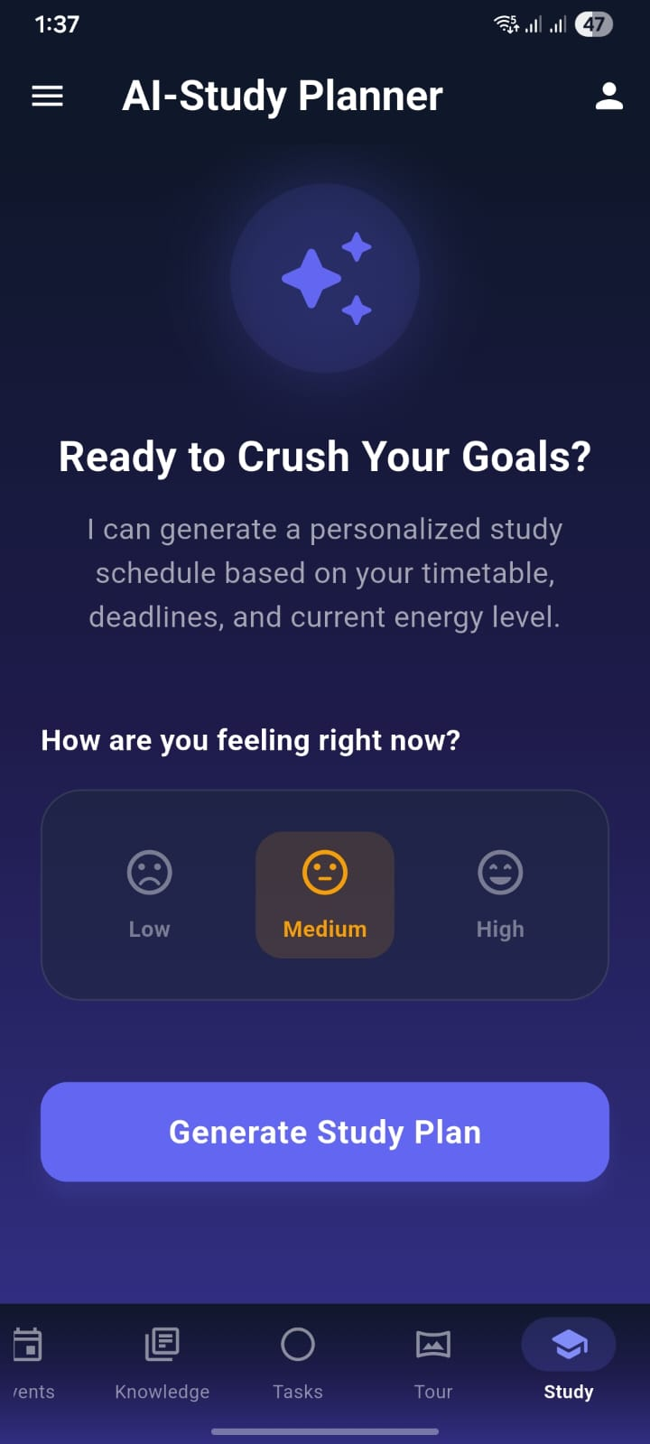
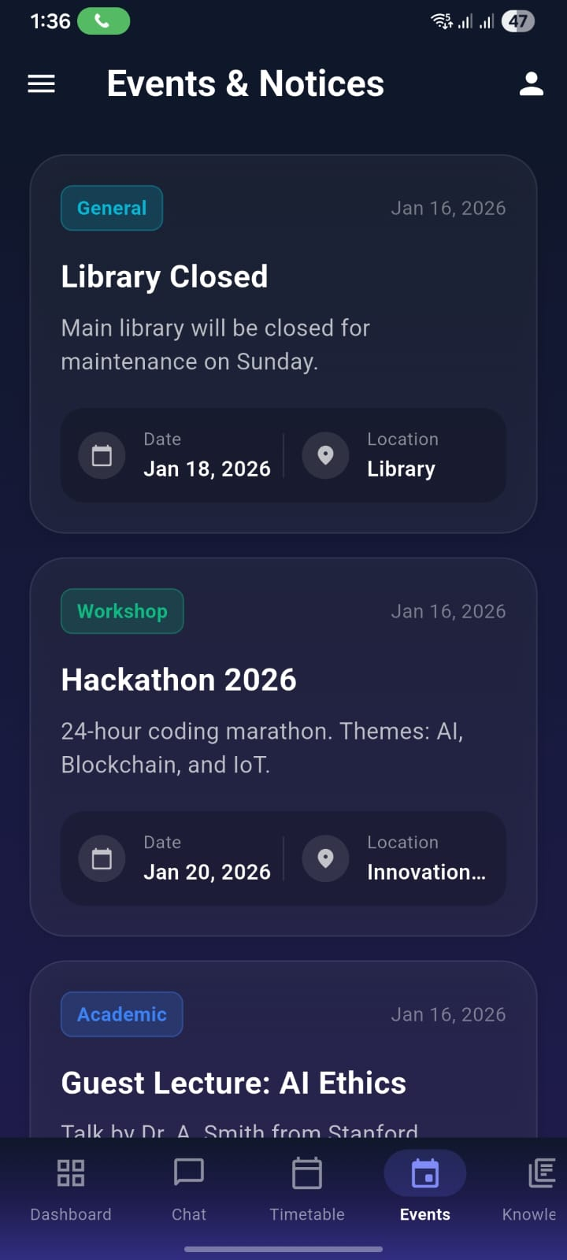
Screenshots of Application
Fig 7: Student Dashboard View
Fig 8: AI Study Planner View
Fig 9: Events & Notices View

Slide 16
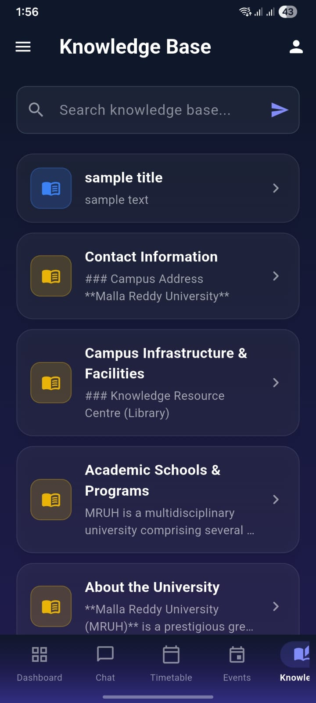
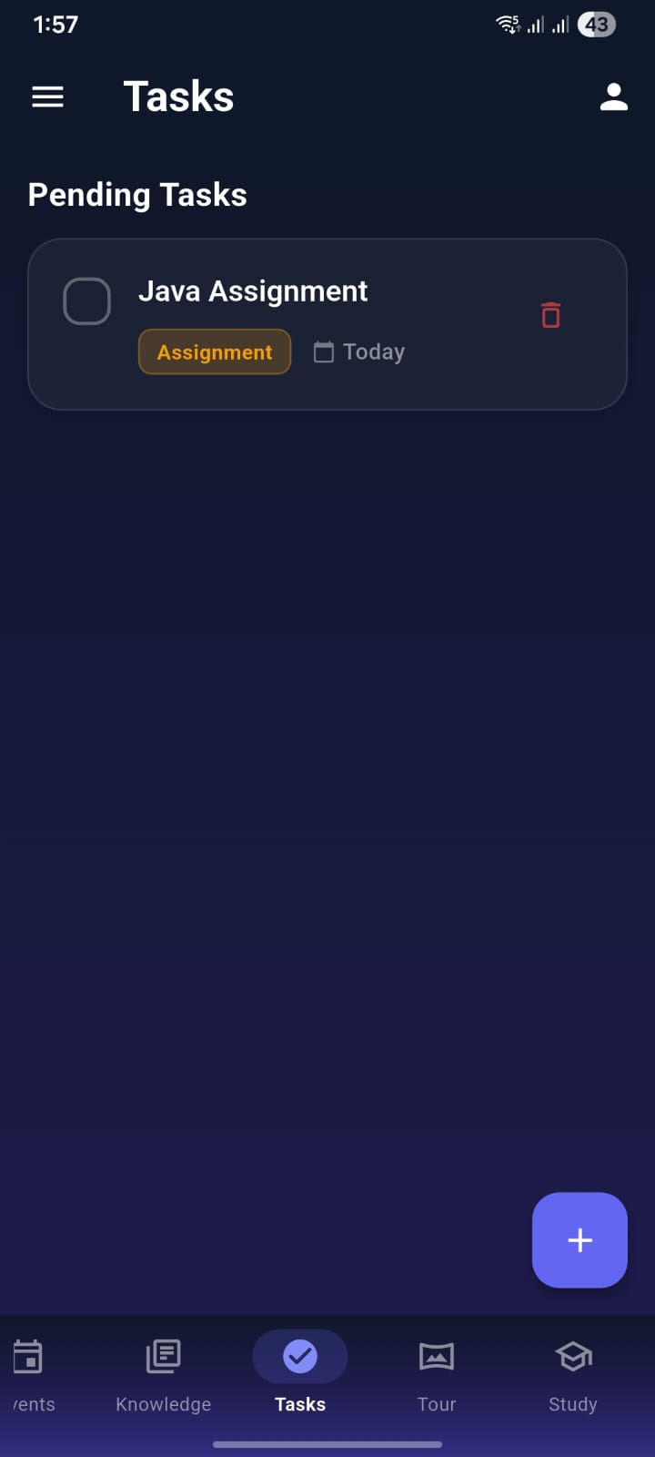
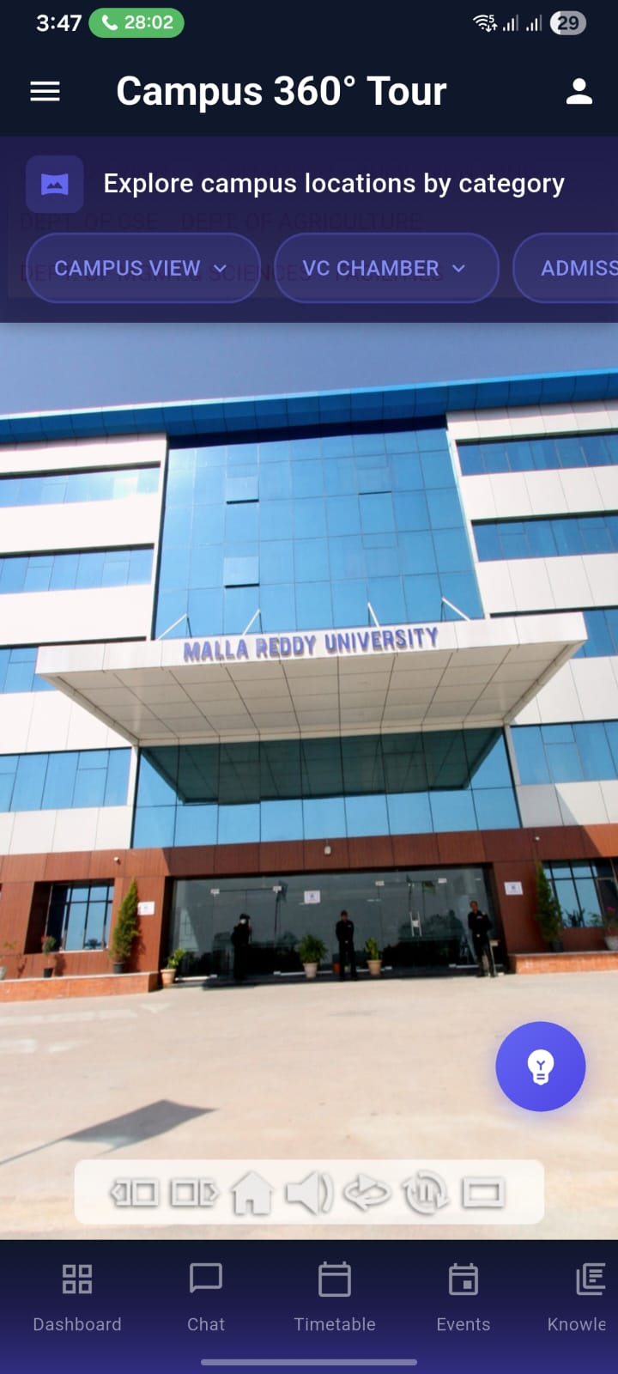
Screenshots of Application
Fig 10: Knowledge Base View
Fig 11: Tasks View
Fig 12: Campus 360° Tour View

Slide 17
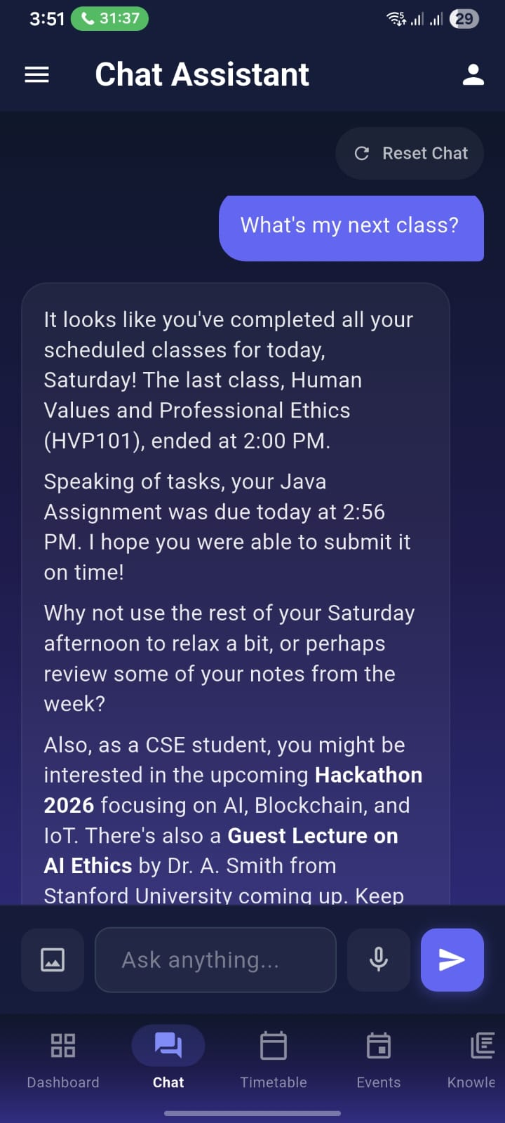
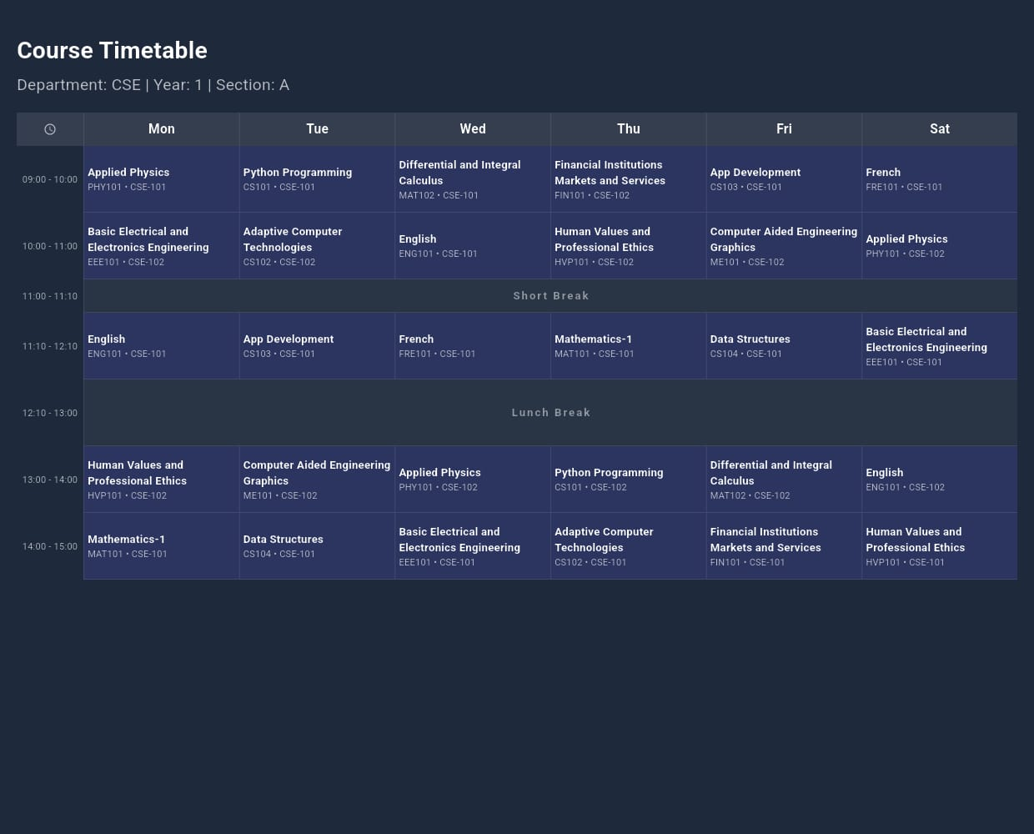
Screenshots of Application
Fig 13: Chat Assistance
Fig 14: Course Timetable Screen

Slide 18
Results
The Proactive Multimodal Academic Support System (PMASS) was implemented and tested across multiple scenarios involving students, faculty, and administrative users.
1. Student Module Results
Context-Aware Responses: AI chat accurately retrieved student-specific timetable information, upcoming deadlines, and course prerequisites.
Multimodal Interaction: Students successfully submitted queries via text, voice, and images. Responses were contextually accurate and delivered in real-time.
Task Management and Planning: Personalized study plans and task reminders were generated based on course schedules and deadlines.
Virtual Campus Navigation: Students could access building locations and navigation guidance through the mobile interface.

Slide 19
Results
2. Faculty Module Results
AI Lecture Assistance: Faculty received suggested lecture outlines, verified resource links, and tone-customized content for lectures.
Student Monitoring: Faculty dashboards displayed student engagement and performance trends, facilitating timely academic interventions.
Content Review: Faculty were able to approve or edit AI-generated academic suggestions, ensuring oversight and maintaining academic integrity.
3. Administrative Module Results
Centralized Timetable Management: Bulk import of schedules and management of institutional data was seamless.
Role-Based Access Control: RBAC and Row-Level Security effectively restricted data access based on user roles.
System Monitoring: Administrators could track AI usage, system health, and database activity through dashboards.

Slide 20
Results
4. System Performance Results
Resilience: Multi-key AI load balancing prevented service downtime due to API rate limits, maintaining continuous service even during peak loads.
Reduced Latency: Heartbeat keep-alive mechanisms minimized cold-start delays in serverless deployments, providing fast response times.
Accuracy: Retrieval-Augmented Generation (RAG) integration with vectorized institutional documents significantly reduced AI hallucinations, improving factual correctness and relevance of responses.
User Satisfaction: Testing with students and faculty indicated high usability and positive feedback for the proactive AI assistance and seamless interface.

Slide 21
Conclusion
The Proactive Multimodal Academic Support System presents an intelligent and efficient solution to the limitations of traditional academic management platforms. By integrating role-based access control with AI-driven automation and proactive academic support, the system streamlines administrative processes, enhances academic planning, and improves student engagement. Features such as personalized scheduling, automated administrative assistance, and continuous performance monitoring enable early intervention and informed decision-making. The proposed system reduces manual workload for faculty and administrators while providing students with timely, personalized guidance. Overall, this project demonstrates how artificial intelligence can be effectively applied to create a scalable, proactive, and student-centric academic support system suitable for modern educational institutions.

Slide 22
References
Predicting Student Performance Application using Machine Learning (Frontiers, 2024).
AI in Education: Personalized Scheduling (Springer, 2023).
Robotic Process Automation in Higher Education (Elsevier, 2021).
Integration of Artificial Intelligence Performance Prediction and Learning Analytics to Improve Student Learning in Online Engineering Courses
Proactive and Reactive Engagement of Artificial Intelligence Methods for Education: A Review

Slide 23
THANK YOU

